Slide 1
Introduction to
IT Project Management
Prof. Dr. Elshaimaa Ramdan
Teaching Assistants:
Rana Alaaeldin
Salwa Megahed
Sherrie Kareem
Tutorial 5
Spring Semester 2019
IT Project Management-Tutorial 5

Slide 2
What is Project Scope Management ?
IT Project Management-Tutorial 5

Slide 3
What is Project Scope Management ?
Project scope management includes the processes involved in defining and controlling what is or is not included in a project
IT Project Management-Tutorial 5

Slide 4
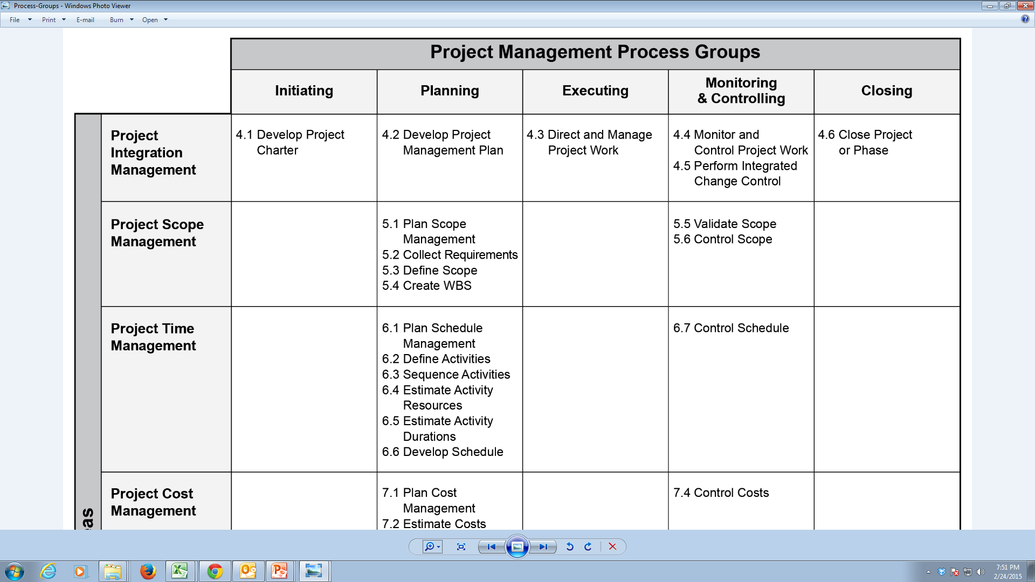
Knowledge areas VS Project Management process groups
IT Project Management-Tutorial 5

Slide 5
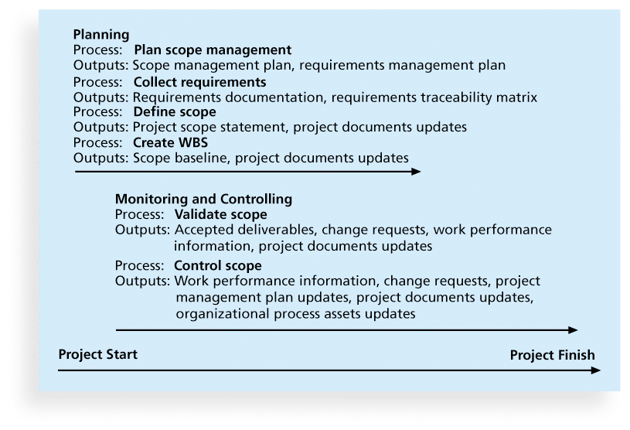
Project Scope Management main Processes:
IT Project Management-Tutorial 5

Slide 6
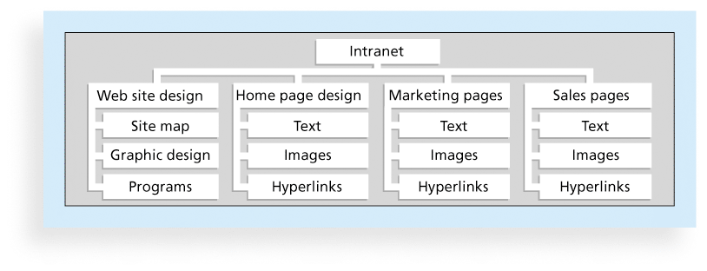
Sample Intranet WBS → Organized by Product
IT Project Management-Tutorial 5

Slide 7
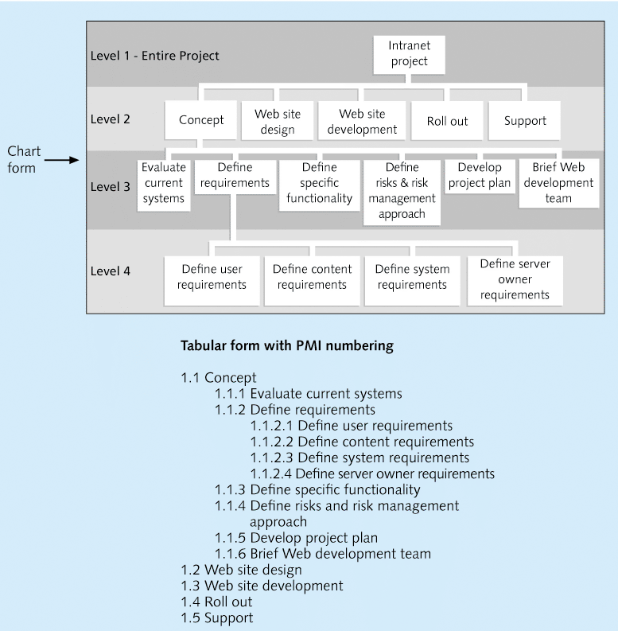
Sample Intranet WBS → Organized by Phase

Slide 8
Approaches to Developing WBSs
Using guidelines: Some organizations provide guidelines for preparing WBSs
The analogy approach: Review WBSs of similar projects and tailor to your project
The top-down approach: Start with the largest items of the project and break them down
The bottom-up approach: Start with the specific tasks and roll them up
Mind-mapping approach: is a technique that uses branches radiating out from a core idea to structure thoughts and ideas
IT Project Management-Tutorial 5

Slide 9
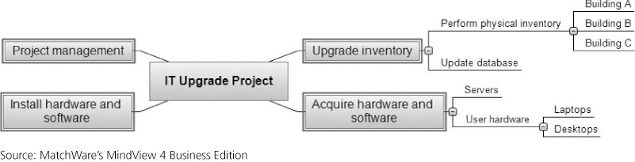
Sample Mind-Mapping Approach for Creating a WBS
IT Project Management-Tutorial 5

Slide 10
Assignment 1:
The Video Game Delivery Project
Due date: Thursday, 21st of March 2019 by maximum 4:00 PM
IT Project Management-Tutorial 5

Slide 11
In class Assignment, each 4 members:
Determine project idea
Create WBS (Product / Phases)
Estimate sequences and durations
View Gantt Chart and Network Diagram
IT Project Management-Tutorial 5

